Slide 1



Presentation VIII
Inverse-Adding Doubling Method
Thu Ta Zaw
2415121095

Slide 2

Overview
Inverse Adding-Doubling (IAD) method
Inverse Adding-Doubling (IAD) is a numerical method used to determine the intrinsic optical properties of turbid media:
Absorption coefficient (μₐ)
Scattering coefficient (μₛ)
Anisotropy factor (g)
From experimental measurements:
Total diffuse reflectance (Rₜ)
Total diffuse transmittance (Tₜ)
Unscattered / collimated transmittance (T_c)

Slide 3
Inverse Adding-Doubling Algorithm
IAD works by repeatedly simulating light propagation (Adding-doubling) and adjusting optical parameters until simulation matches measurement.
IAD uses an iterative, trial-an-error approach to solve the radiative transport equation.
The optical properties calculated from the algorithm are compared with measured value until they are in agree.

Slide 4
Inverse Adding-Doubling Algorithm
Why IAD?
Beer’s Law cannot compute the scattering condition, so it is useless for tissue
Kubelka-Munk is inaccurate for high anisotropy as it is based on 2-flux approximation.
Diffusion Approximation fails when there is high absorption, thin samples, low scattering and strong anisotropy g > 0.7.
Monte Carlo algorithm is an accurate one, but it is slow and expensive.
IAD solves all these problems by using a full radiative transport solver but still fast enough for iteration.

Slide 5

Radiative Transport Equation
RTE describes how light moves inside a scattering medium.
$\text{μ} \frac{\text{​}\text{∂}\text{L}\text{(}\text{z}\text{,}\text{μ}\text{)}}{\text{∂}\text{z}}=\text{−} \text{(}{ \text{μ}}_{a }\text{​+}{ \text{μ}}_{s }\text{​)} \text{+}{ \text{μ}}_{s }\int_{−1}^{1}{\text{p}\text{(}\text{μ}\text{,}\text{μ}\text{′)}\text{L}\text{(}\text{z}\text{,}\text{μ}\text{′)} \frac{\text{d}\text{μ}\text{′}}{2}\text{​} }$ ​​
$\text{L}\text{(}\text{z}\text{,}\text{μ}\text{)}\text{ =}$ radiance
${ \text{μ}}_{a }$= absorption coefficient
${ \text{μ}}_{s }$= scattering coefficient
$\text{p}\text{(}\text{μ}\text{,}\text{μ}\text{′)}$ = phase function (Henyey-Greenstein)
g = anisotropy (average cosine of scattering angle)
The RTE cannot be solved analytically for real material with anisotropy and refractive index mismatch.
Thus, IAD uses a numerical method to solve RTE: the Adding-Doubling Method (AD)

Slide 6

Forward Model
Adding-doubling is a numerical method to compute R($\text{μ}$) (reflection) and T($\text{μ}$) (transmission) as a function of angle) for a slab.
For a “single-scattering” thin slab, reflectance and transmittance can be calculated exactly from:
${ \text{μ}}_{s }$, ${ \text{μ}}_{a }$, g
Phase function
Fresnel reflection at boundaries (if n ≠ 1)
For double the slab thickness:
If the value of ${ \text{R}}_{d }$ and ${ \text{T}}_{d }$ for thickness d is known, the ${ \text{R}}_{2d }$, ${ \text{T}}_{2d }$ for thickness 2d can be computed.
This accounts for infinite internal reflection between the two identical slabs, and possible to continue doubling d, 2d, 4d, 8d and …

Slide 7
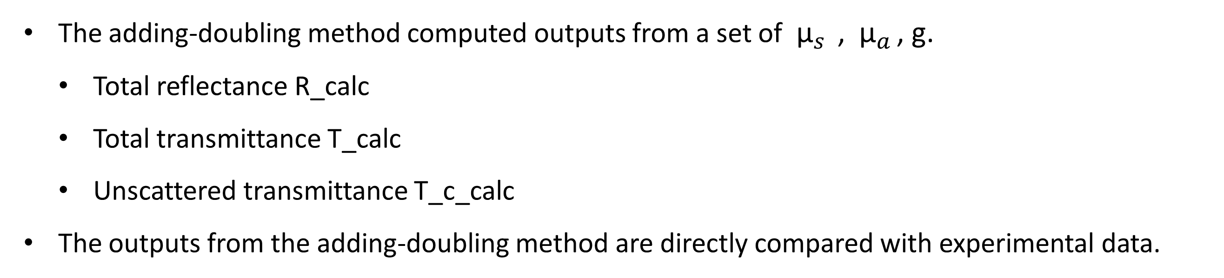
Output of Forward Model
The adding-doubling method computed outputs from a set of ${ \text{μ}}_{s }$, ${ \text{μ}}_{a }$, g.
Total reflectance R_calc
Total transmittance T_calc
Unscattered transmittance T_c_calc
The outputs from the adding-doubling method are directly compared with experimental data.

Slide 8
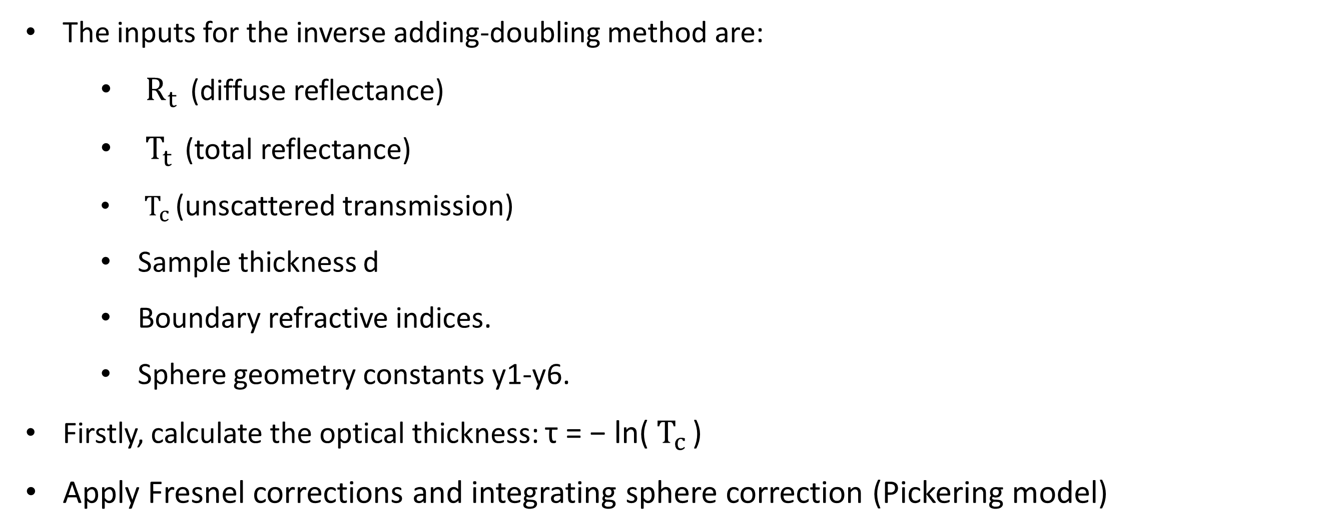
Inverse Adding-Doubling
The inputs for the inverse adding-doubling method are:
${ \text{R}}_{t }$ (diffuse reflectance)
${ \text{T}}_{t }$ (total reflectance)
${ \text{T}}_{c }$(unscattered transmission)
Sample thickness d
Boundary refractive indices.
Sphere geometry constants y1-y6.
Firstly, calculate the optical thickness: τ = − ln(${ \text{T}}_{c }$​)
Apply Fresnel corrections and integrating sphere correction (Pickering model)

Slide 9

Inverse Adding-Doubling
IAD wraps an optimization loop around the adding-doubling solver.
Initial parameter guess (${\text{μ}}_{s }$, ${ \text{μ}}_{a }$, g ).
Repeat until convergence for the forward model, compute error metric and update the (${\text{μ}}_{s }$, ${ \text{μ}}_{a }$, g ).
The converged outputs are (${\text{μ}}_{s }$, ${ \text{μ}}_{a }$, g , a , τ ).
The advantages of the IAD methods are:
The IAD is extremely accurate, error < 3% (4 quadrature points), error < 1% (8 quadrature points)
It is fully general for any albedo, any sample thickness and high anisotropy.
Can handles internal reflection.
It works for biological tissue, ceramics, powders, bone scaffolds and … etc.

Slide 10
Inverse Adding-Doubling
IAD requires 1D homogenous slab, and it is not suitable for multilayer tissues, and highly heterogeneous samples.
IAD requires accurate measurement which makes it sensitive to experimental errors.
It will have convergence issues if initial guesses are not good.
Phase function must be assumed
It is computationally heavier than diffusion even though it is fast.

Slide 11
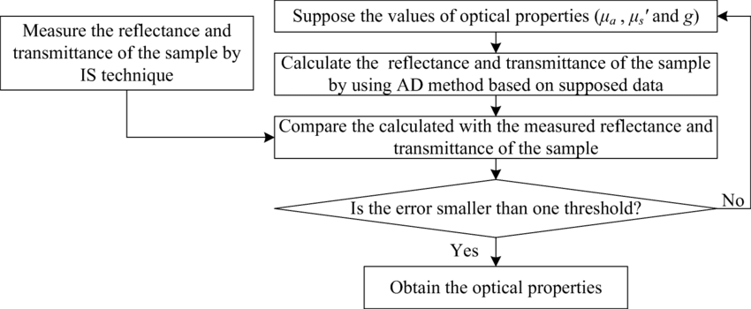
Procedure of IAD
Fig. Process Diagram of IAD

Slide 12
The End
THANK YOU FOR LISTENING
Thu Ta Zaw
2415121095

